Slide 1

Customer Success Manager Advisory Bot
Customer Success GPT

Slide 2





Problem Statement:
Customer Success teams are essential for maintaining strong customer relationships and reducing churn. However, they often lack actionable insights into user behaviour within the application.
Problem:
1. Feature Blindness:
Customer Success teams lack insight into user feature engagement, hindering targeted support.
2. Unaddressed Pain Points:
Customer Success teams must identify and address underutilized or disliked features.
3. Retention Challenges:
Low user engagement can lead to churn.We need to find ways to enhance customer stickiness and prevent attrition.

Slide 3
Solution space and user persona
Our goal is to leverage application usage data to empower Customer Success teams. By understanding feature adoption, addressing dissatisfaction, and improving overall user experience, we aim to boost customer satisfaction and retention.
Identify Popular Features:
Determine which features are most frequently used by customers.
Understand the reasons behind their popularity.
2. Address User Dissatisfaction:
Identify features that receive low adoption or negative feedback.
Investigate the root causes of dissatisfaction.
3. Enhance Customer Stickiness:
Propose actionable strategies to improve customer engagement.
Optimize feature adoption and overall user experience.

Slide 4

















Solution Model
LLMOps
Database with user Demographic and Feature usage data
Data Pre-Processing
Creating Statistical Database
Splitting Data
Machine Learning Algorithms
Churn Prediction
Prompts
Queries
End Users
API
Web-Apps
Database with Feedback data
Text Pre-processing
Feature Extraction
Sentiment Analysis
Sentiment Classification
Gen AI Model
Model Versioning
Model Caching
Model Monitoring

Slide 5
Solution Model
LLMOps
Database with user Demographic and Feature usage data
Data Pre-Processing
Machine Learning Algorithms
Churn Prediction
Prompts
Train-test Splitting
Queries
End Users
API
Web-Apps
Database with Feedback data
Text Pre-processing
Sentiment Analysis
Sentiment Classification
Gen AI Model
Model Versioning
Model Caching
Model Monitoring

Slide 6
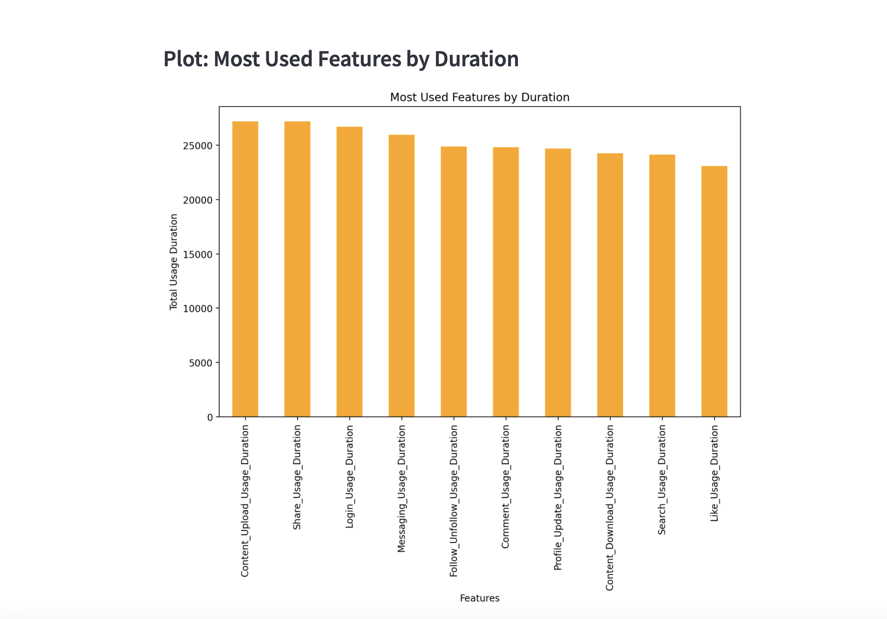
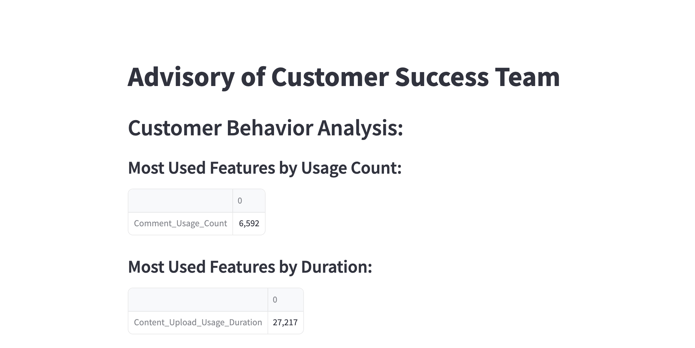
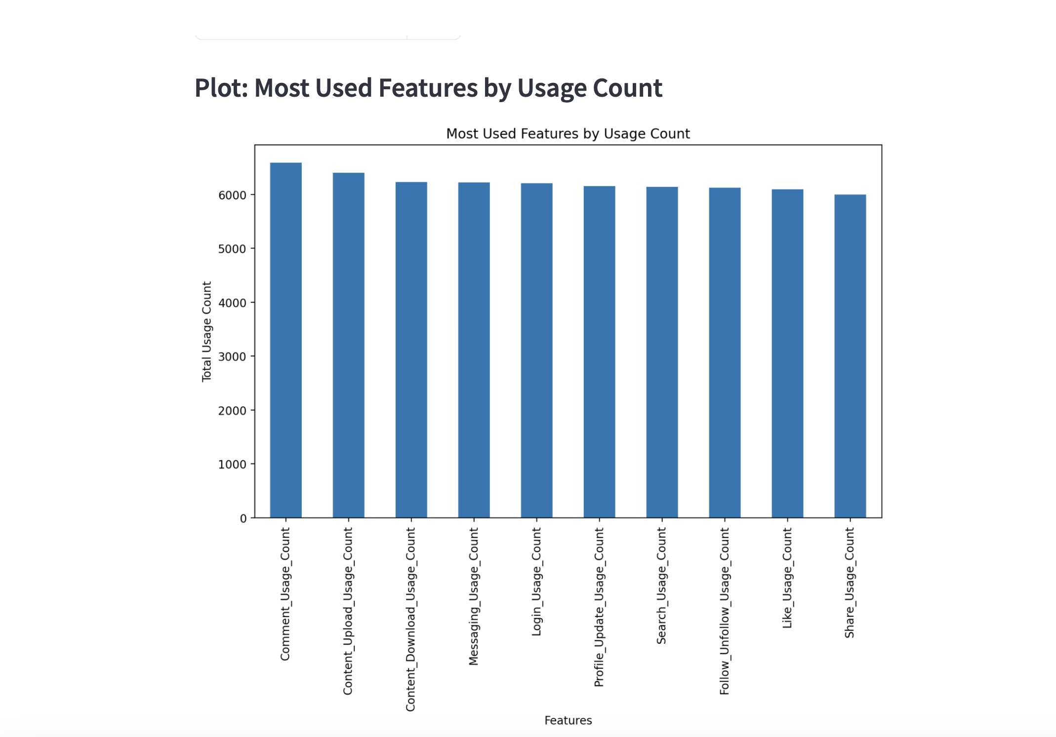
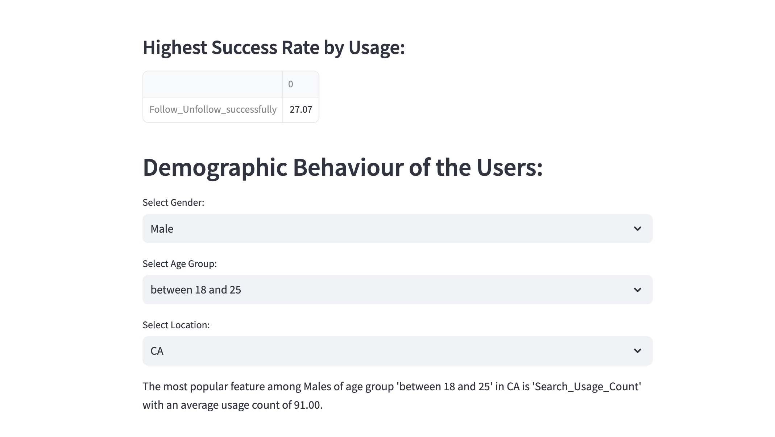
Solution Snippet:
Part 1: User Data Analysis

Slide 7
Part 2: User Behavior Analysis Based on Demography

Slide 8
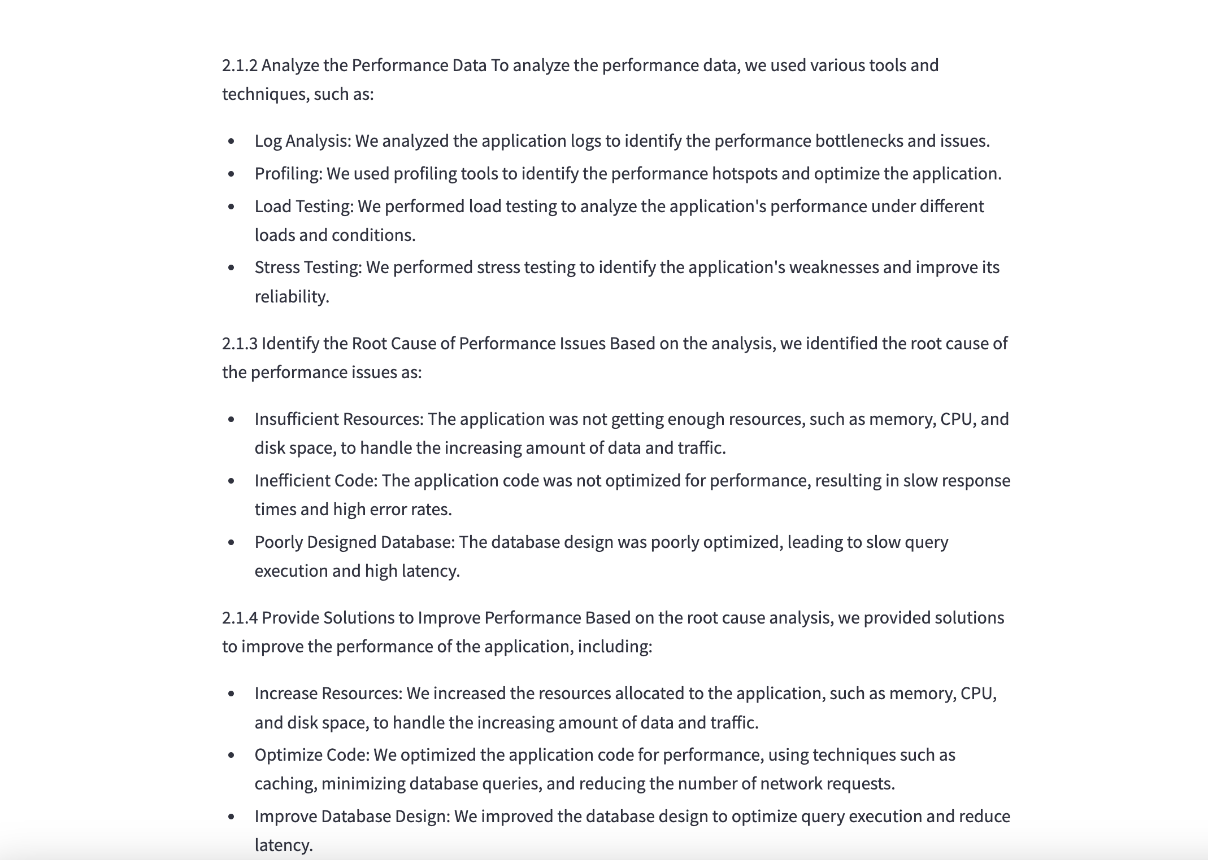
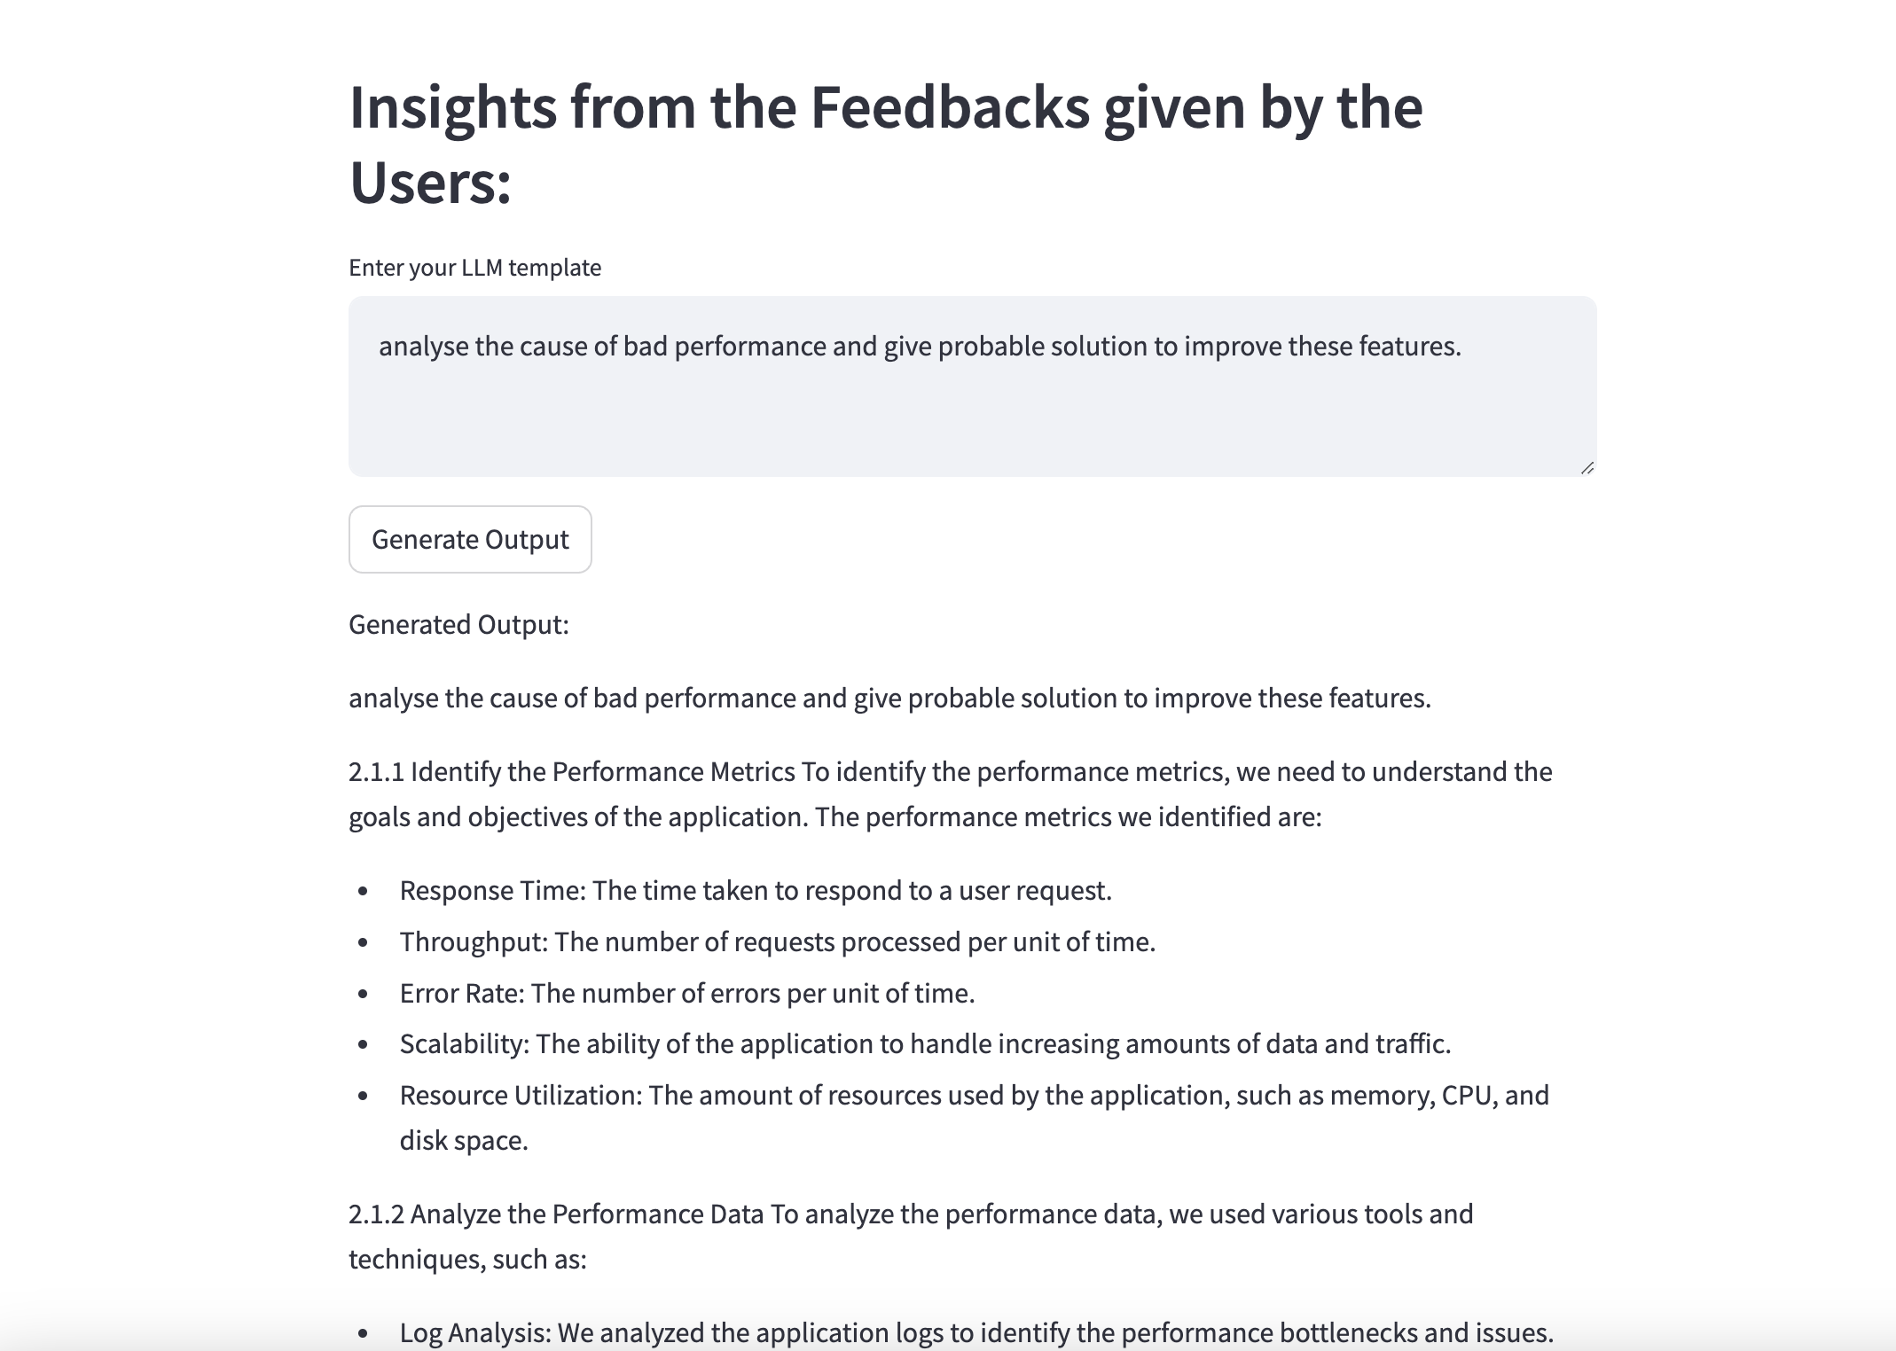
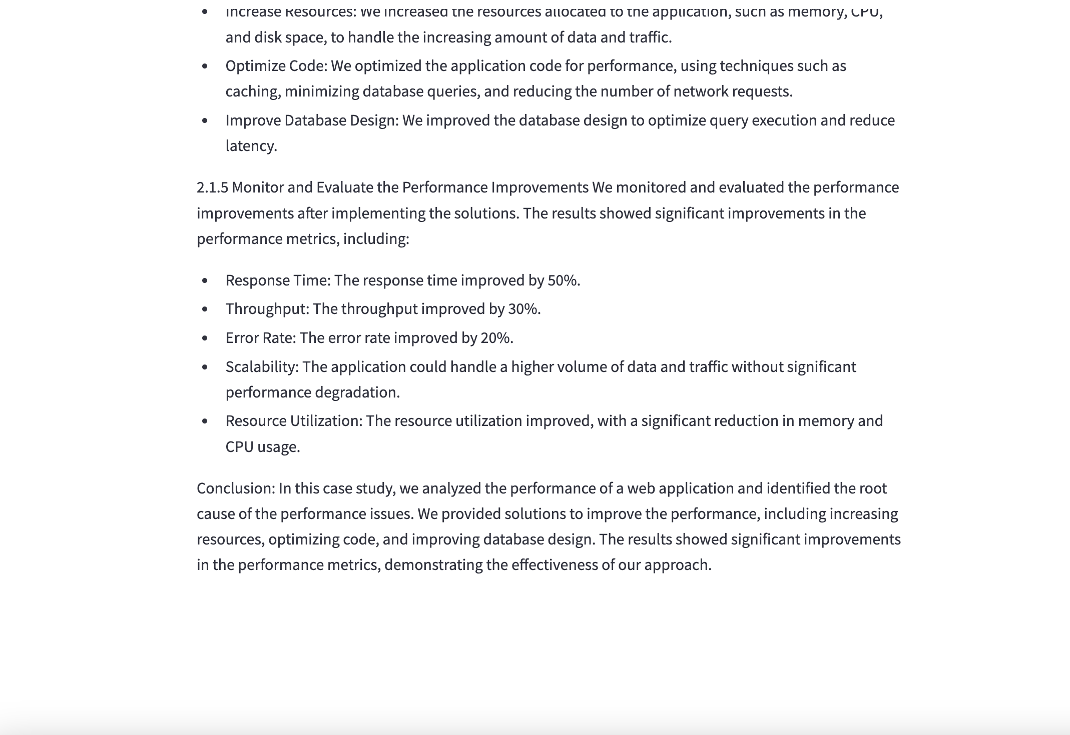
Part 3: Getting Insights from Feed Back Analysis
Example-1

Slide 9
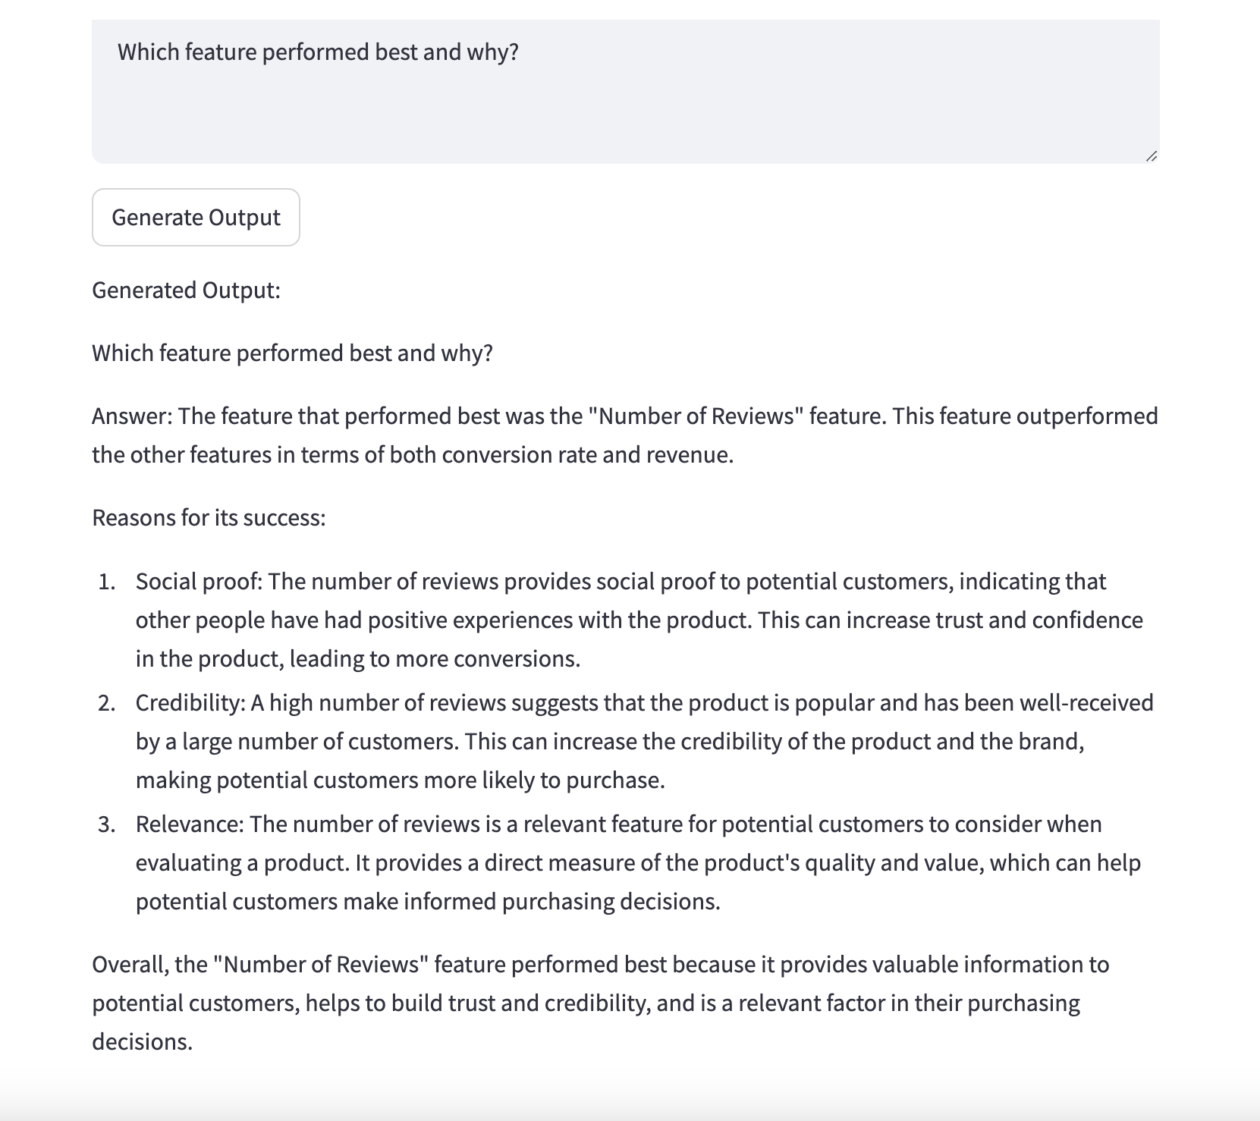
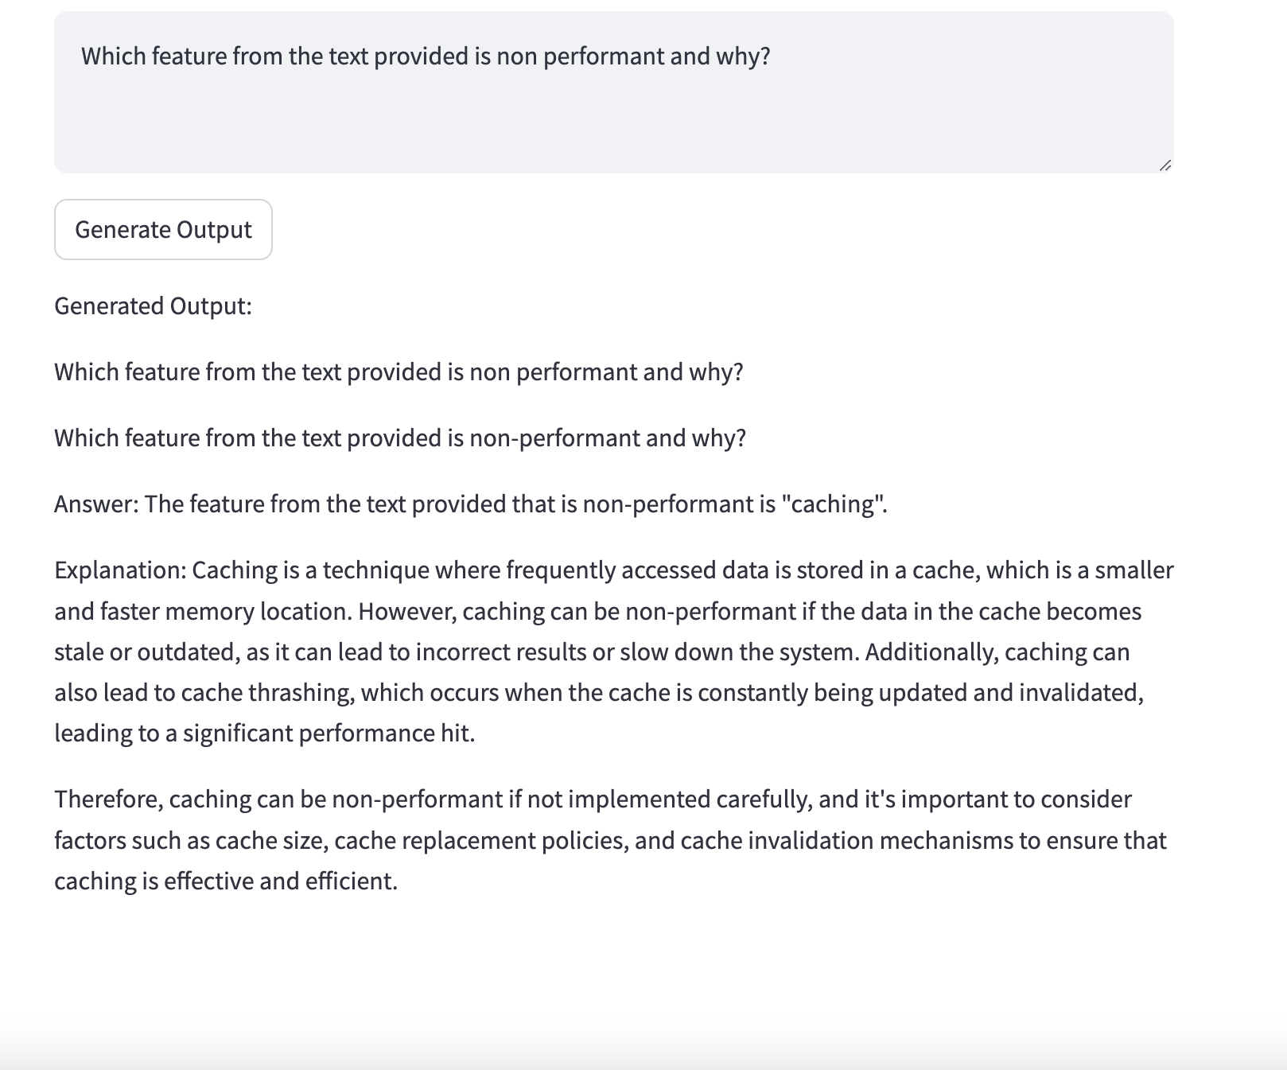
Example-2
Example-3

Slide 10
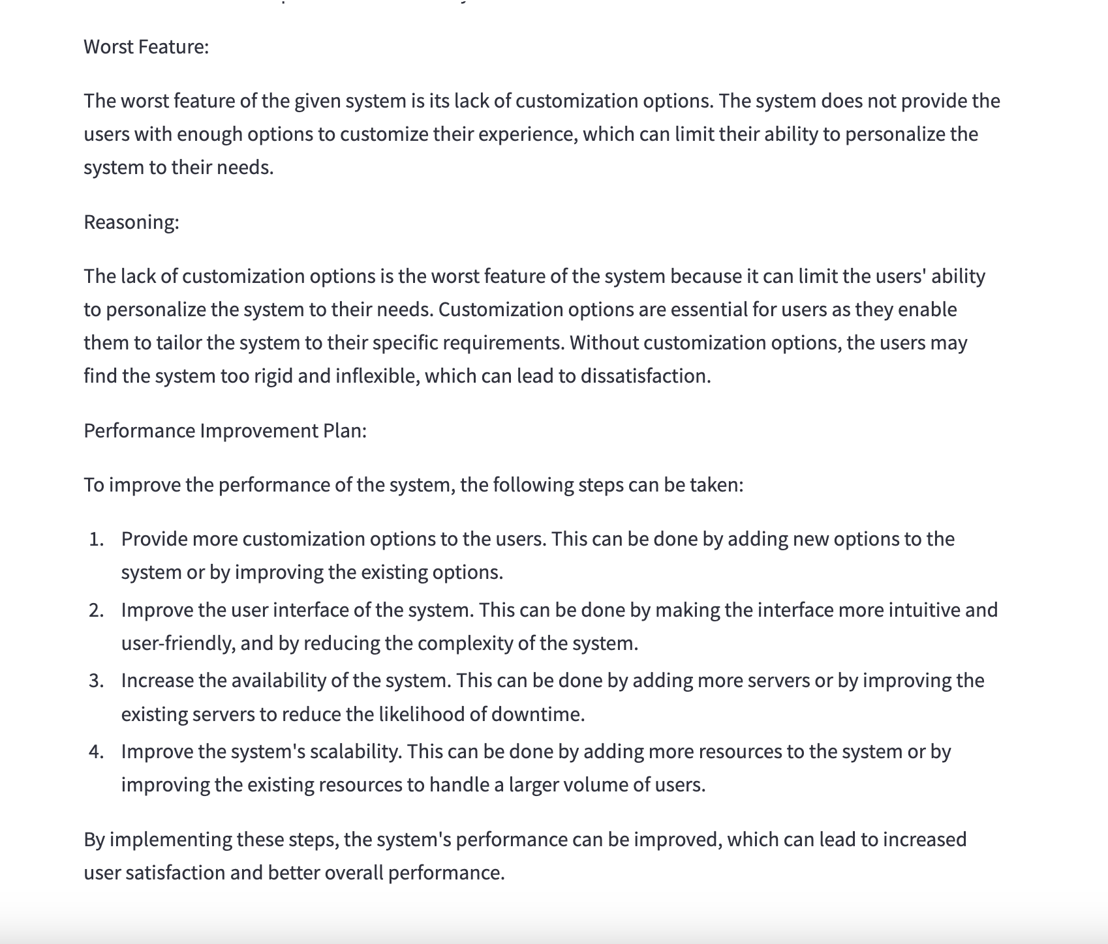
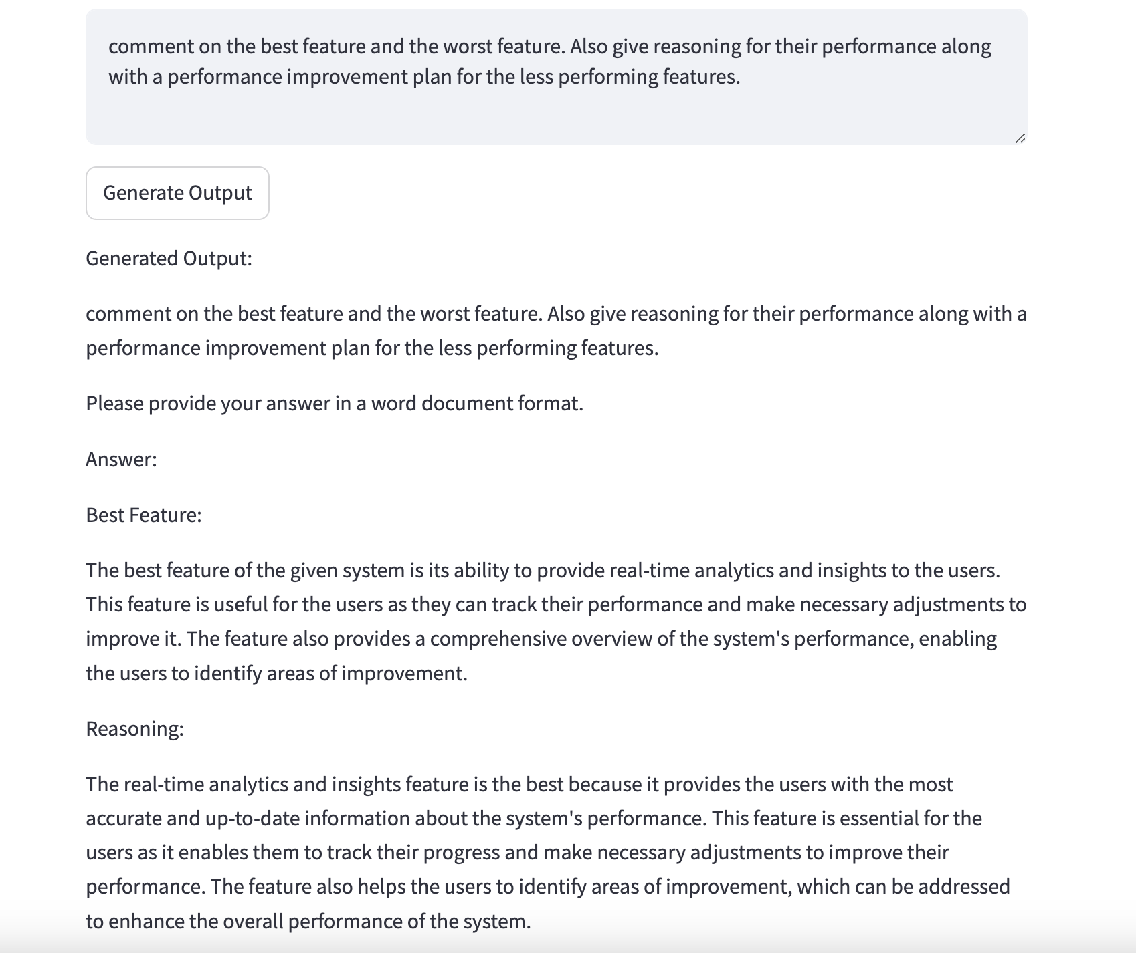
Example-4

Slide 11
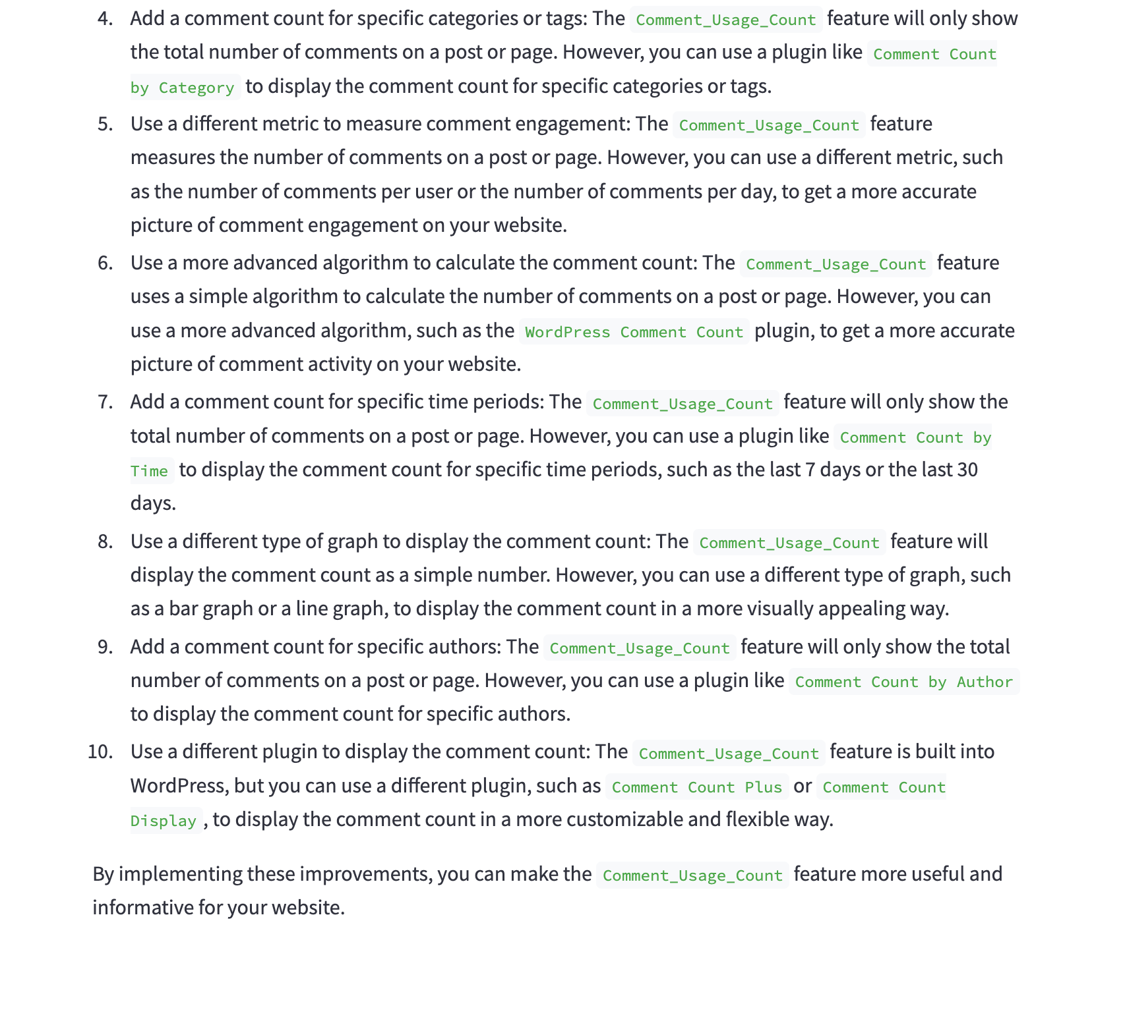
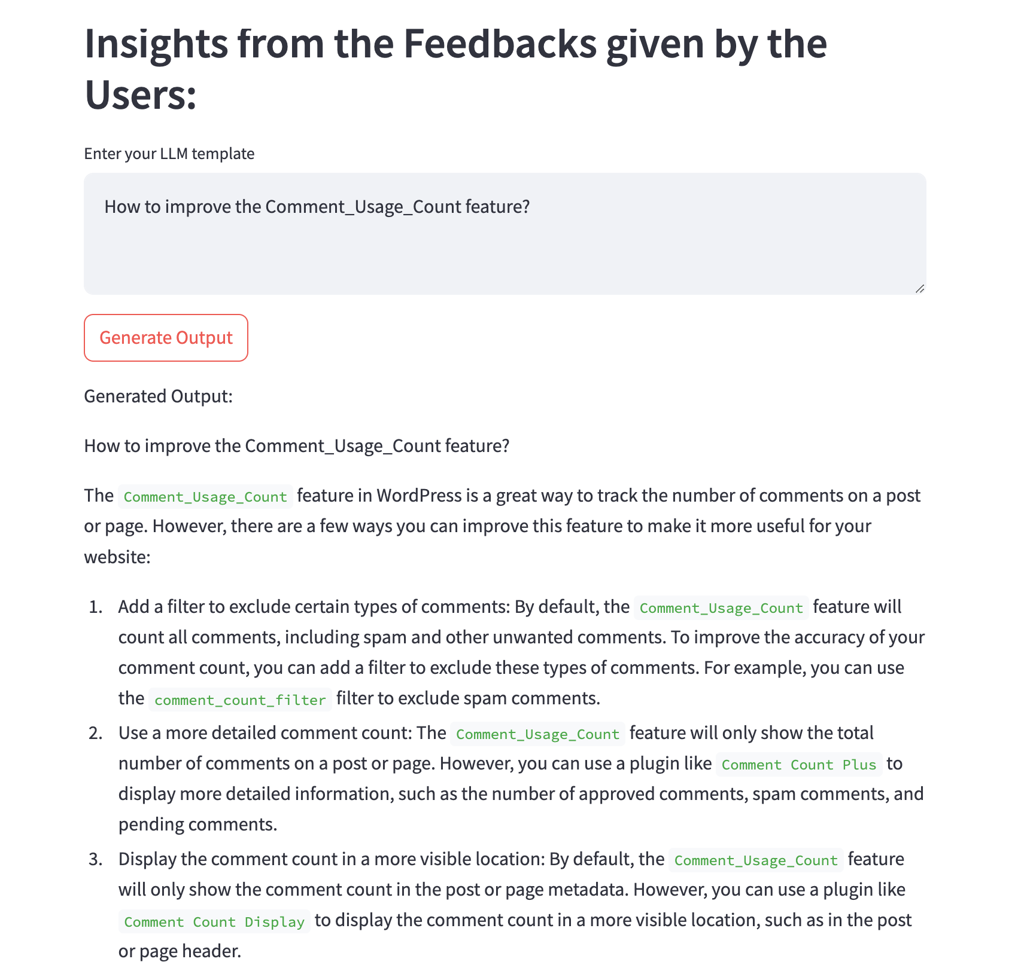
Example-5

Slide 12
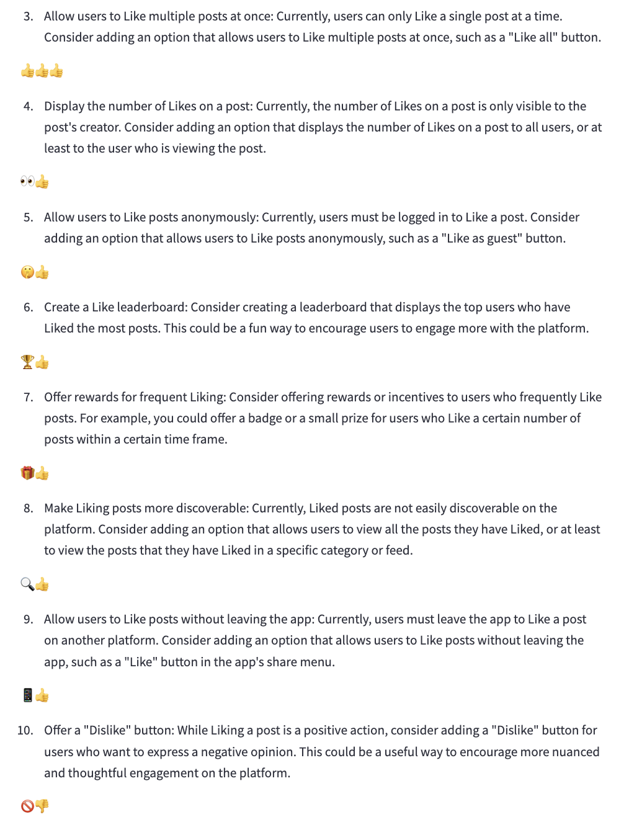
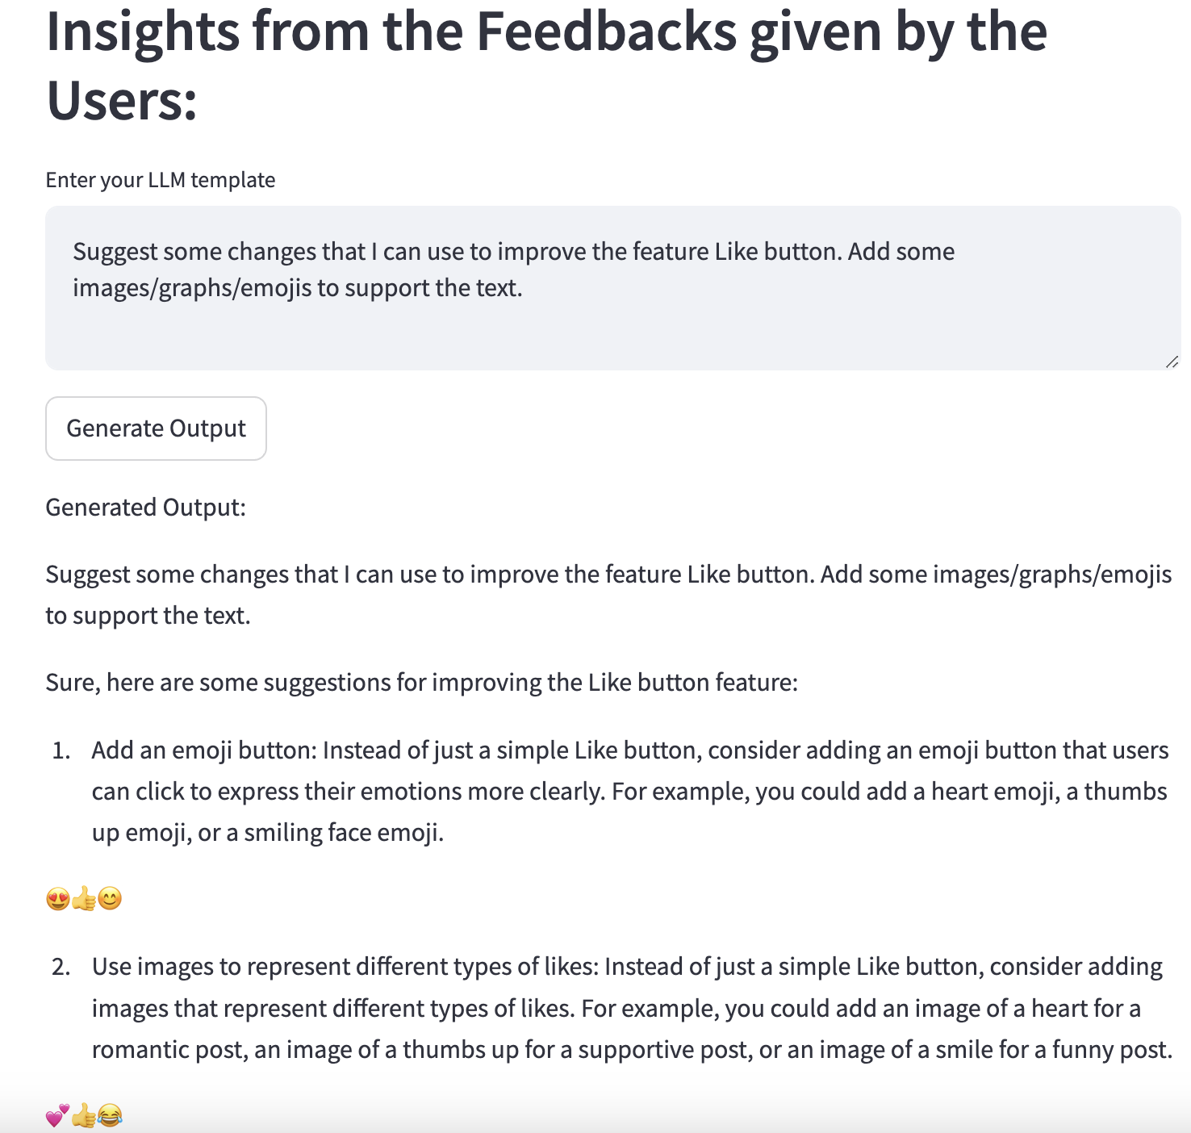
Example-6

Slide 13
Some Important Points: 1. The churn prediction for customer retention is another feature that is added with the other features. 2. Two types of dataset are being used here. A) user specific information data B) event specific feedback data from users

Slide 14
THANK YOU

